Slide 1

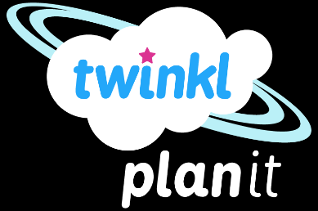
Computing
Online Safety
Year One
Computing | Year 3 | Online Safety | Keep It to Yourself | Lesson 3

Slide 2
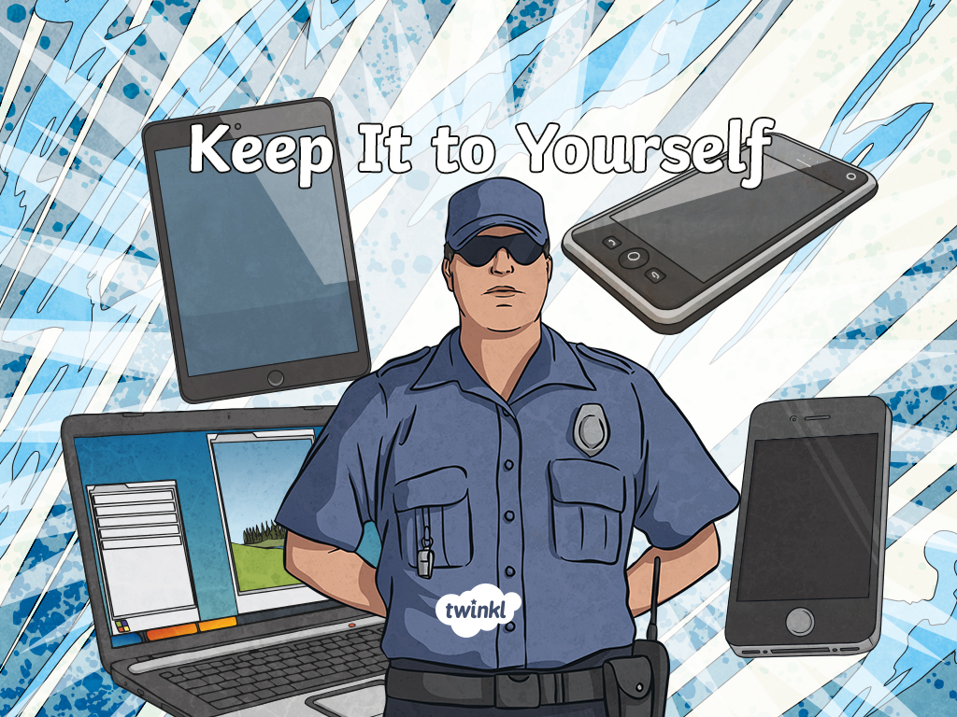

Slide 3
Aim
To create strong passwords and understand privacy settings.
Success Criteria
I can create a strong password.
I can explain why a strong password is important.
I can explain what privacy settings are.

Slide 4
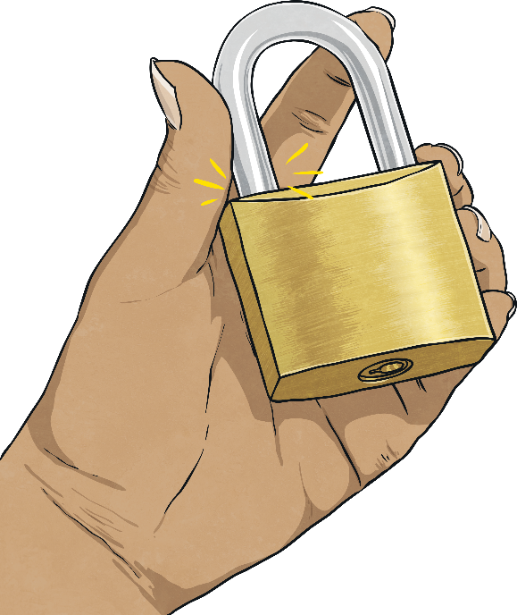
What Is a Password?
What is a password?
Something to keep your things safe
A lock
A secret
A code

Slide 5
What Is a Password?
Why do we use them?
To stop people seeing our information.
To stop people using our accounts.
To make sure only you can change your information.
Remember: adults will probably have more password-protected accounts than children and these could be for very important things.

Slide 6
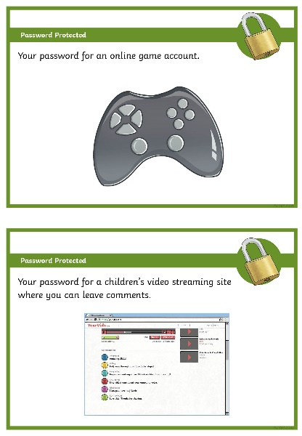
Keep Out!
In a group, look at the card you have been given.
Discuss how you would feel if someone had your password for the site on your card.
What could happen if someone had the password to that account?
What information could they find out?
What could they use your account for?
Could it harm you?

Slide 7
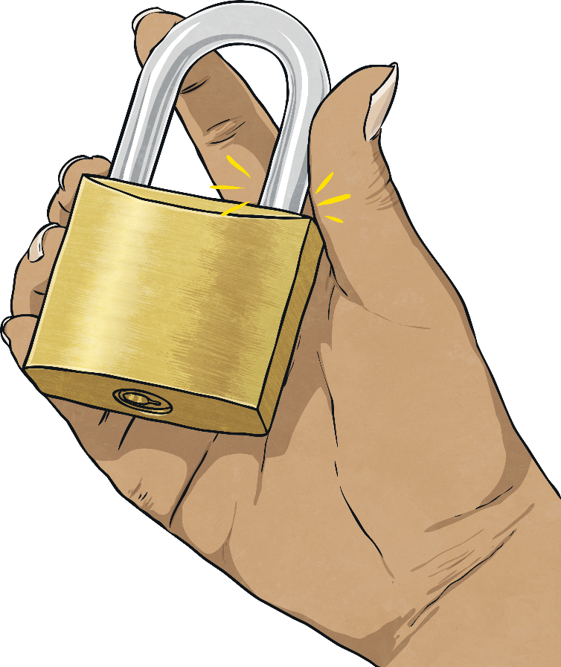
Protect Yourself
Passwords stop people from getting into your account, but they also stop people from seeing any private information that might be in your account.
When you make an account, you might have your name, address, phone number, email or even bank details stored there.
If someone has your password, they might be able to see all of that information!

Slide 8
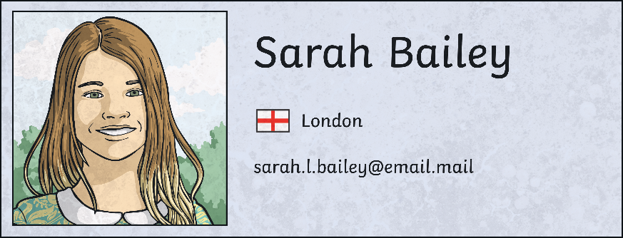
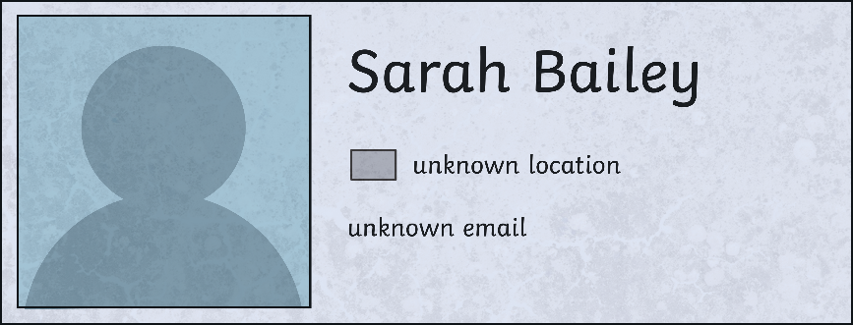
Protect Yourself
Another easy way to protect your information is to always choose to use strong privacy settings.
Privacy settings mean that you can control what people can see on your account.
It’s the difference between a stranger seeing this:
Or this:
?
?
?
Which one would you prefer a stranger seeing?

Slide 9
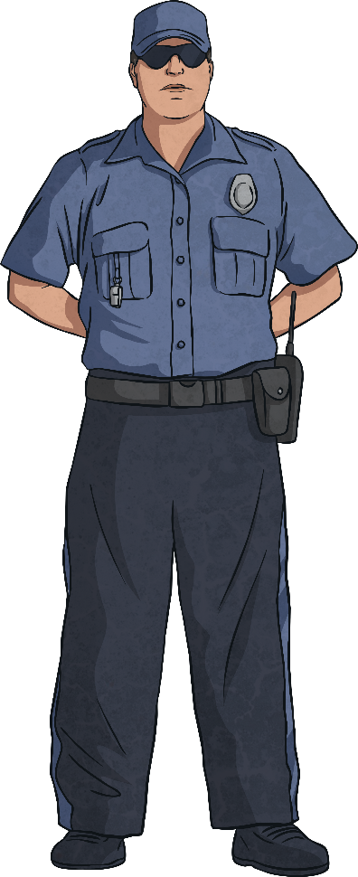
Tough Security
On whiteboards, rank these passwords from 1-5 (most to least secure).
(a pet’s name) Fluffy123
Password123
Abcde12345
(random word and number) pencil21
A1btD!bq
Remember - never share your password!
Password b is the least secure… But it’s actually one of the most common passwords in the world!
The most secure is password e. It uses capital letters, lowercase letters, numbers, symbols and no real words.
?
?
?
Can you explain your choices?

Slide 10
Tough Security
Which of these four privacy settings would you advise someone to use on a children’s social media site?
Your whole profile can be seen by friends.
You can choose which parts of your profile can be seen by both strangers and friends.
Anyone can see your whole profile, just be careful what you put on there (open profile).
No part of your profile can be seen by anyone.
Option 4 is definitely the most secure, but the second option could also be safe. If you are unsure, it is best to stick to the fourth option or ask an adult you trust to help.

Slide 11
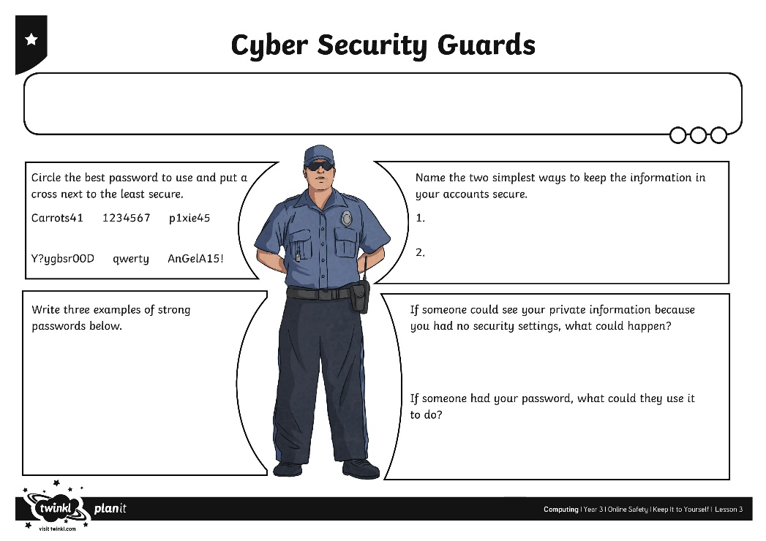
Cyber Security Guards
?
What makes a secure password?
What could happen if you do not have a secure password?
?
?
Complete the Cyber Security Guards Activity Sheet to show how much you know about the importance of passwords and privacy settings.

Slide 12
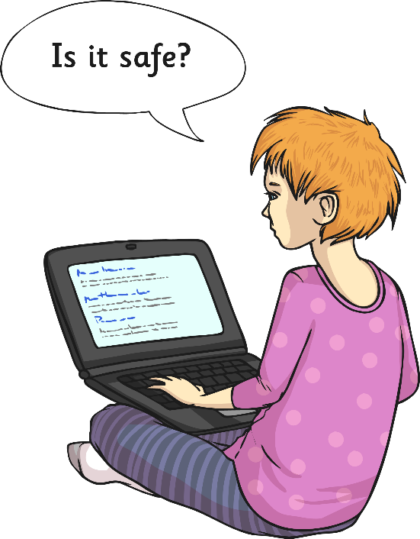
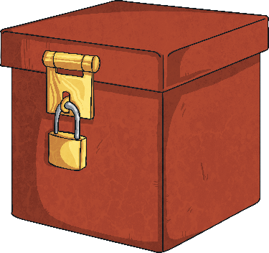
Top Tips
Why should you pick a hard-to-guess password?
Who should you share your passwords with?
Why should you use privacy settings?
Passwords and privacy settings are both really, really good ways of keeping your information private and keeping you safe online.

Slide 13

Aim
To create strong passwords and understand privacy settings.
Success Criteria
I can create a strong password.
I can explain why a strong password is important.
I can explain what privacy settings are.

